Slide 1
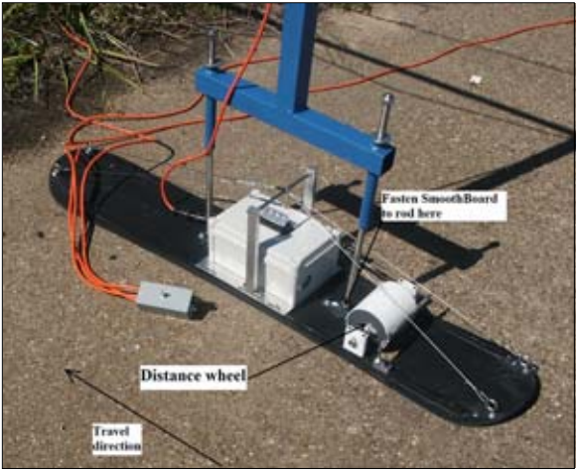
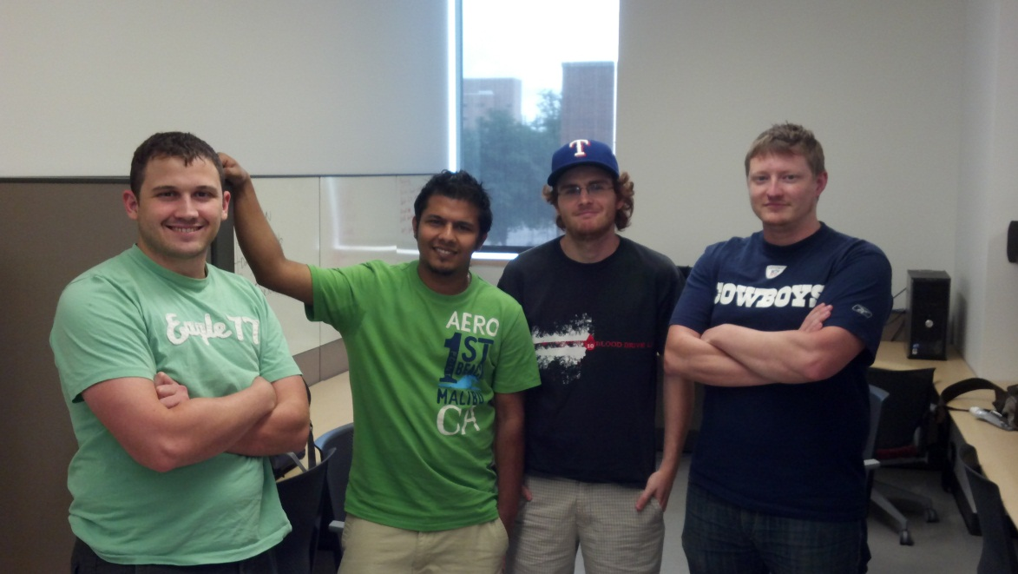
The Builders Group Ltd.
Sliding Profiler
Notes:
CM starts

Slide 2
Overall Planning
Phase 1
SRS
Project Charter
Team Meetings
Sponsor Meetings
R&D

Slide 3
Overall Planning Contd.
Phase 2
ADS
DDS
Test Plan
Implementation
Team Meetings
Sponsor Meetings

Slide 4
WBS SRD
Dawg Ganeshpur
Customer Requirements
Feasibility Assessments
Future Items
Beaver Hercules
Product Concept
Product Description and Functional Review
Packaging Requirements
Safety Requirements

Slide 5
WBS SRD Contd.
Penny Rachel
Acceptance Criteria
Use Cases
Bandit Bloomfield
Performance Requirements
Maintenance and Support Requirements
Other Requirements

Slide 6
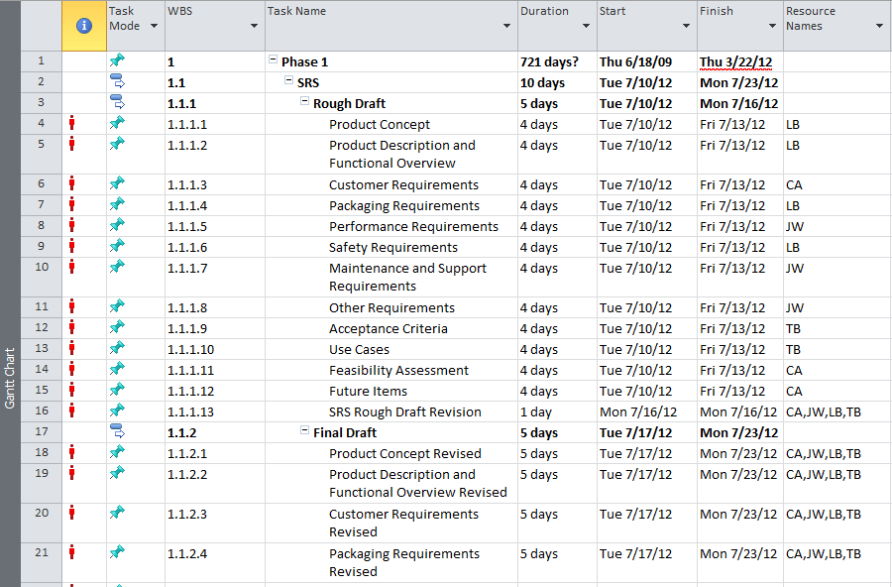
SRD Snapshot

Slide 7
WBS Project Charter
Dawg Ganeshpur
Cost Management Plan
Work Breakdown Structure
Beaver Hercules
General Organization
Scope Statement
Quality Management Plan
Procurement Management Plan

Slide 8
WBS Project Charter Contd.
Penny Rachel
Scope Management Plan
Communication Plan
Project Closeout Report
Bandit Bloomfield
Earned Value Management
Risk Management Plan
Change Management Plan

Slide 9
Personnel Risks
Name | Priority(1-5) | Likelyhood(%) | Size of loss (weeks)
Personnel Availability | 4 | 80 | 2
Lack of Buy-in | 5 | 20 | 3
Burnout | 1-2 | 95 | 2
Sponsor Availability | 5 | 50 | 2

Slide 10
Product Risks
Name | Priority(1-5) | Likelyhood(%) | Size of loss (weeks)
Doesn't float | 1 | 40 | 3
Extreme Temp Failure | 1 | 40 | 3
Frame Resilience | 4 | 30 | 2
Project Failure | 1 | 30 | 4

